Slide 1

Welcome to:
Thursday, October 6th, 2016
Broun Hall Room 235

Slide 2
Introduction
Founded in 2006 by the Auburn University ECE Department
Acts as a “makerspace” that provides a place for students to work collaboratively on projects.
Provides the space, tools, and some resources for these projects.
No prior experience is required.
Great for students of all ages and majors.
Can act as a pathway to get involved in Undergraduate Research.

Slide 3


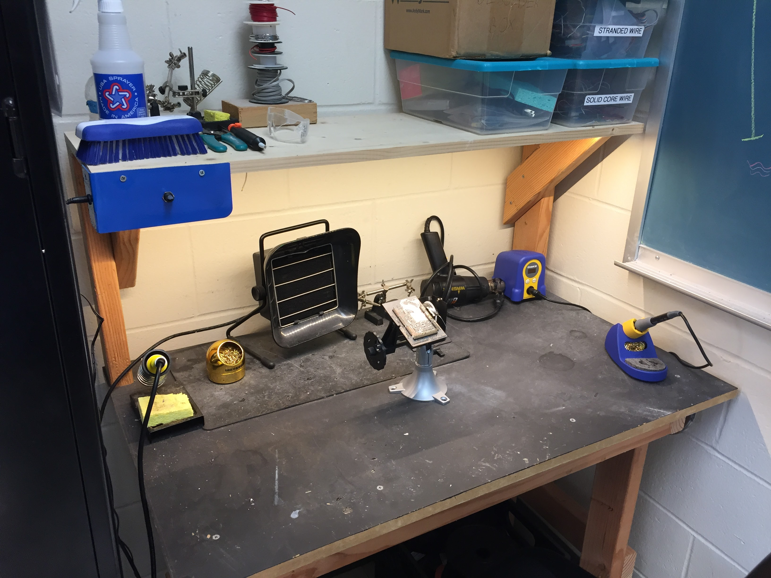
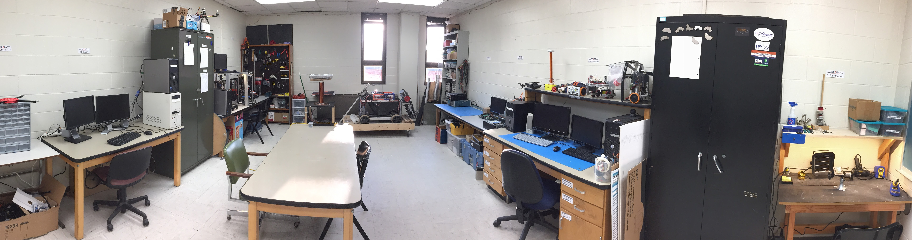
Our Lab
Broun Hall
Room: 367

Slide 4
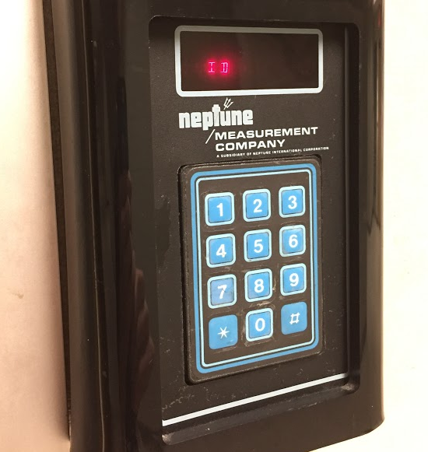
How to become a Member
Log 5 constructive hours in the lab
Write the times on the sheet on the cabinet on the left side of the room.
Contact our Secretary:
William Crubaugh
Email: wcc0023@auburn.edu
Then visit Autry May to get Code Access
Office: Broun Hall Room 252
Email: eceshop@auburn.edu
You will be given code access code that will give you 24/7 access to Broun 367 and Broun Hall.

Slide 5
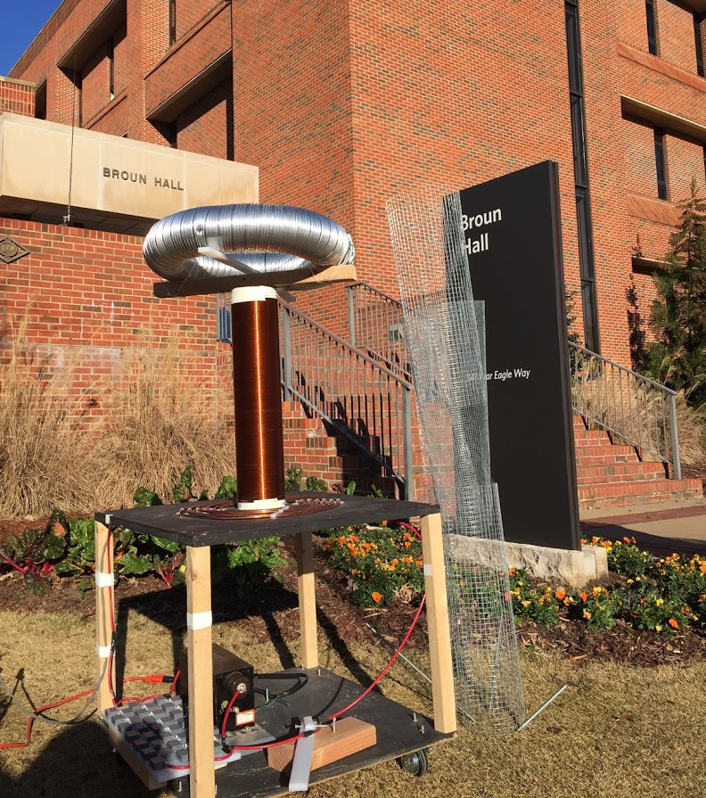
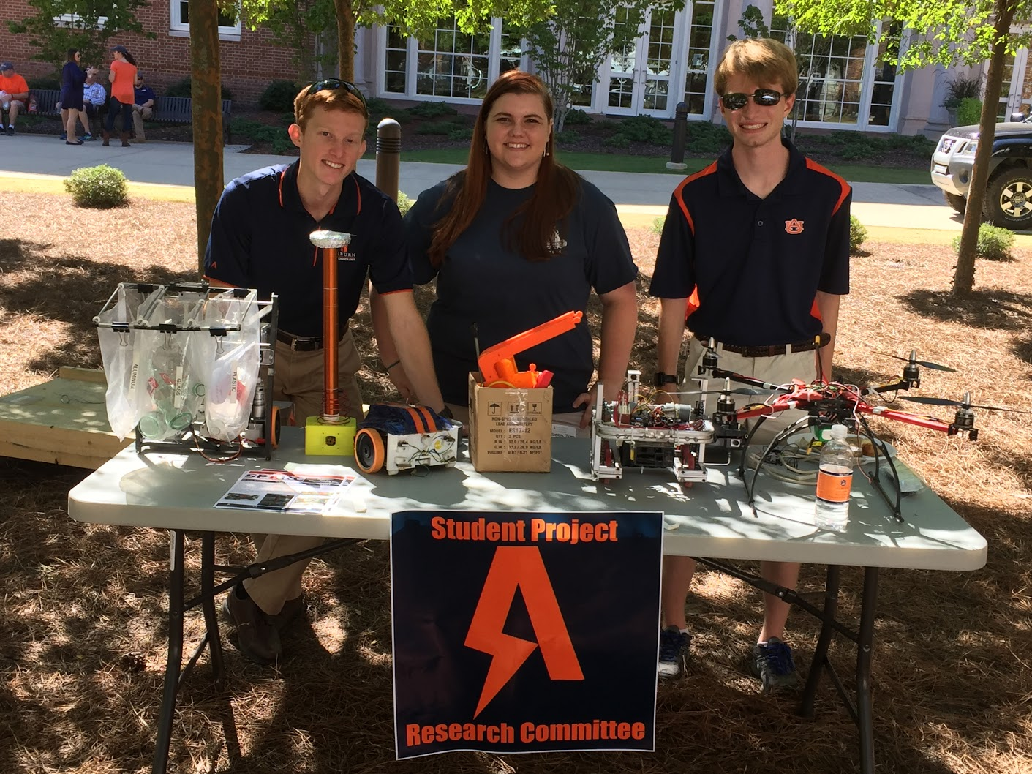
Outreach Events
Outreach Coordinator- Jack Thomas jet0024@auburn.edu
Sanford Middle School in Opelika, AL STEM Event
Thursday October 20 and Friday October 21 8am-2:35pm
Free Breakfast and Lunch
SCORE Robotics Education Program- New program starting this semester
E-Day- Late February or early March
IEEE Sumo Robotics Competition (with local middle and high schools)- Spring 2017
E-Day 2016 Tesla Coil Demonstration
Engineering Tailgate SPARC Table

Slide 6

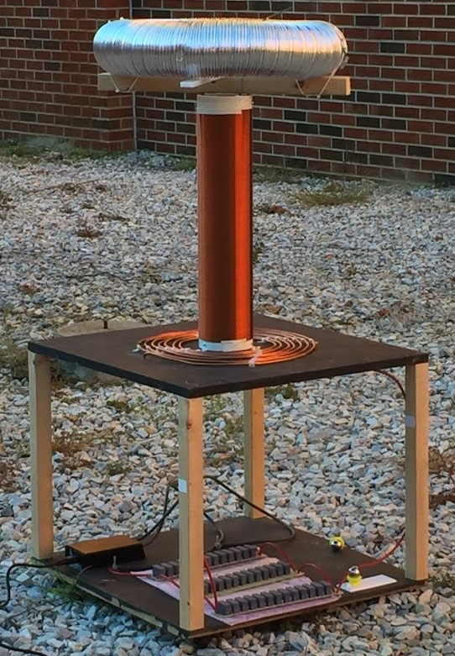
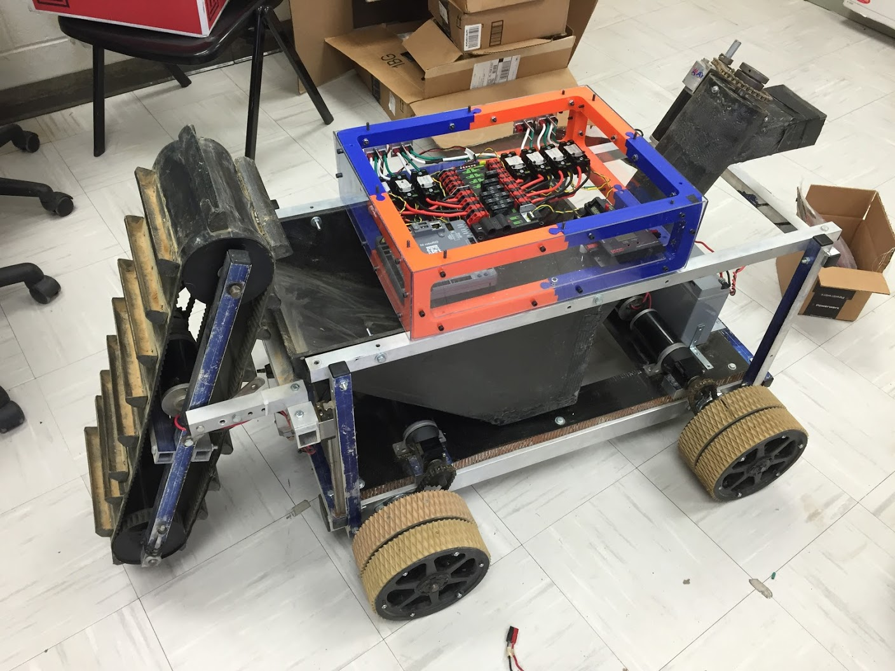
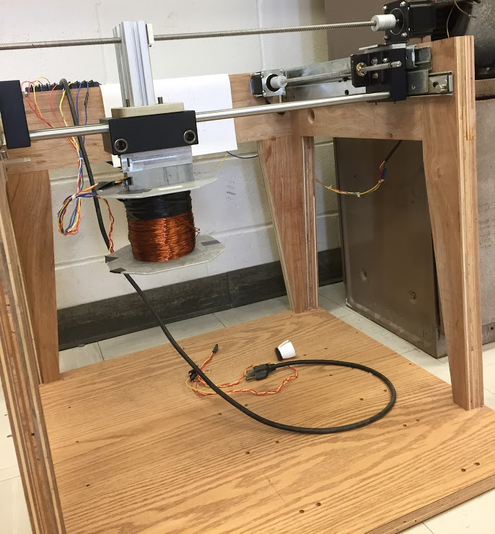
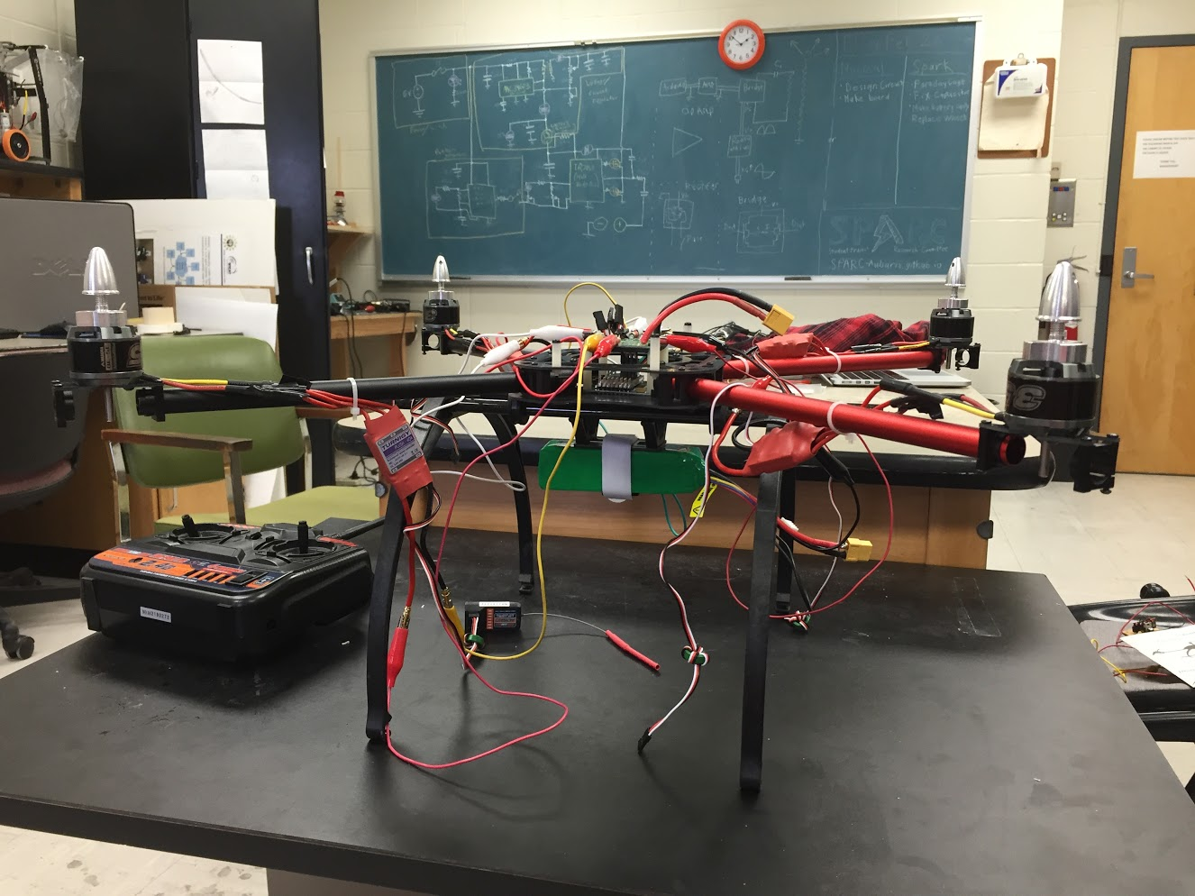
Current Projects and Teams
Robotics and Automation
NASA RMC
Automated Lab
Research
Smart Helmet
MAGLEV
Cryo-Electronics
Unmanned Aerial Vehicles
RC Hobbyist Club
Josh’s Quadcopter
Outreach and Demonstration
Claw Machine
Tesla Coil
Denotes that this project has an active GroupMe

Slide 7
Projects: NASA Robotics Mining Competition
A 3rd Year Robotics team that designs and builds a robot
collects simulated Martian soil in a small arena
dispenses it into a small bin on the other side of the arena.
Can be remotely controlled or for bonus points autonomously controlled
Competition is held at the Kennedy Space Center this year from May 22nd-26th, 2017
Part of Auburn’s SPACE Club and affiliated with SPARC.
Team Lead:
Jeremy Frasher jjf0010@auburn.edu
Meetings:
Mondays 6:15 PM
2016 NASA RMC Robot

Slide 8
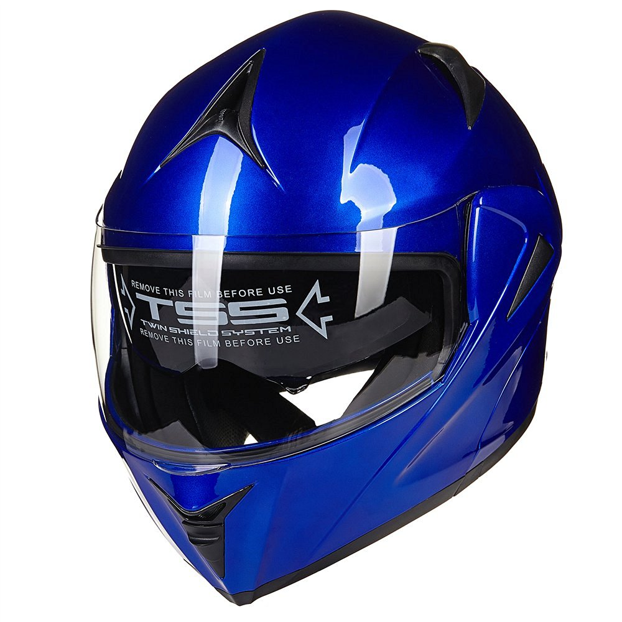
Projects: Smart Helmet
Create an augmented/virtual reality helmet.
Researching various methods for virtual and augmented reality.
Possible Users of this Technology
Motorcyclists
Race Car Drivers
Astronauts
Soldiers
Fighter Pilots
Proposed Capabilities
Rear view
GPS directions
Music abilities
360 Degree Object Detection
Team Lead:
Noah Niedzwiecki nmn0005@auburn.edu
Meetings:
Wednesday 5pm-6pm
Possible Helmet

Slide 9
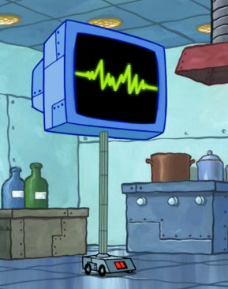
Projects: Automated Lab
Create an automated lab assistant.
Will be voiced controlled.
Will allow door to be unlocked temporarily remotely to allow new members access to the lab.
Will consist of both a stationary and mobile system.
Team Lead:
Josh Jablonowski jdj0019@auburn.edu
Meetings:
Wednesdays 6:00pm-7:00pm
Location- SPARC Lab Broun 367
Kinematic
Autonomous
Robot
Enriches
Newcomers

Slide 10
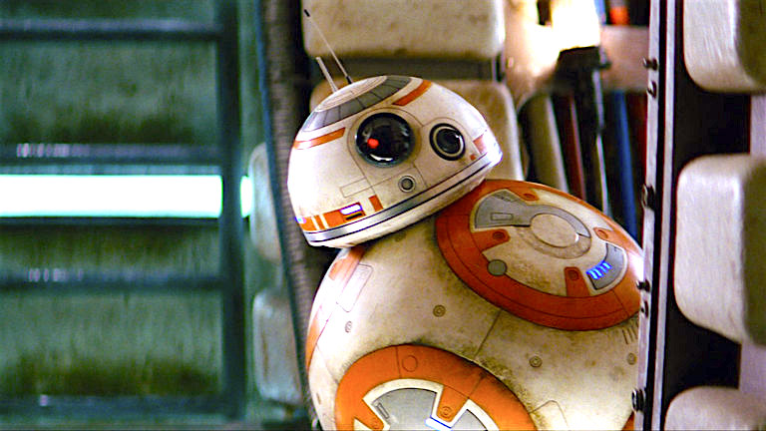
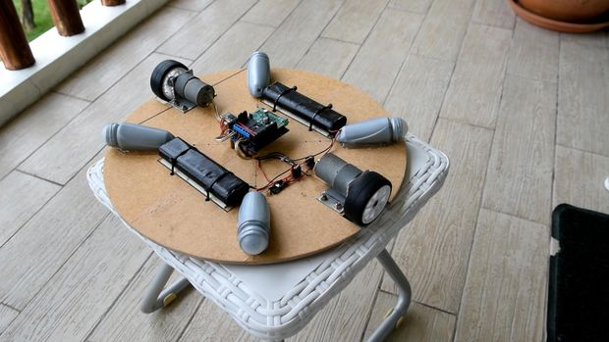
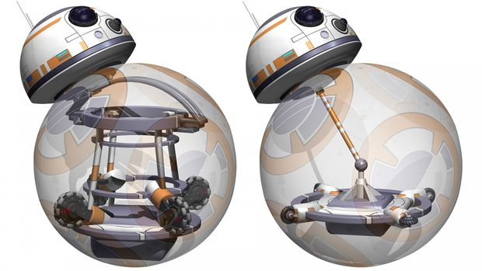
Projects: BB-8 robot
Build a robot that uses an internal mechanism to manipulate a ball to move around.
Also has semispherical “head” with sensors to detect surroundings.
A great E-Day project.
Will possibly be used as a tourbot with a built in projector in the head.
Based off of Instructables tutorial: http://www.instructables.com/id/DIY-Life-Size-Phone-Controlled-BB8-Droid/
Team Lead:
Jonathon Brown
Meetings:
Wednesdays 6:00pm-7:00pm
Location- SPARC Lab Broun 367

Slide 11
Projects: MAGLEV
Originally a senior design project involving magnetic levitation of small metal objects.
Uses 2 dimensional axes to move an electromagnet.
By varying frequency in coil, it can “sing” War Eagle
Also will be used for SCORE Crane Machine
Team Lead:
Shane Williams smw0031@auburn.edu
Meetings:
Not set

Slide 12
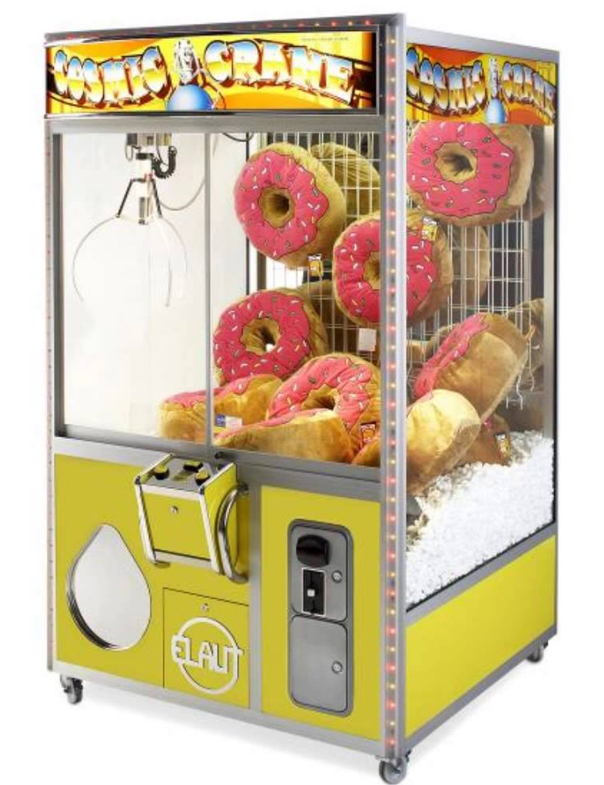
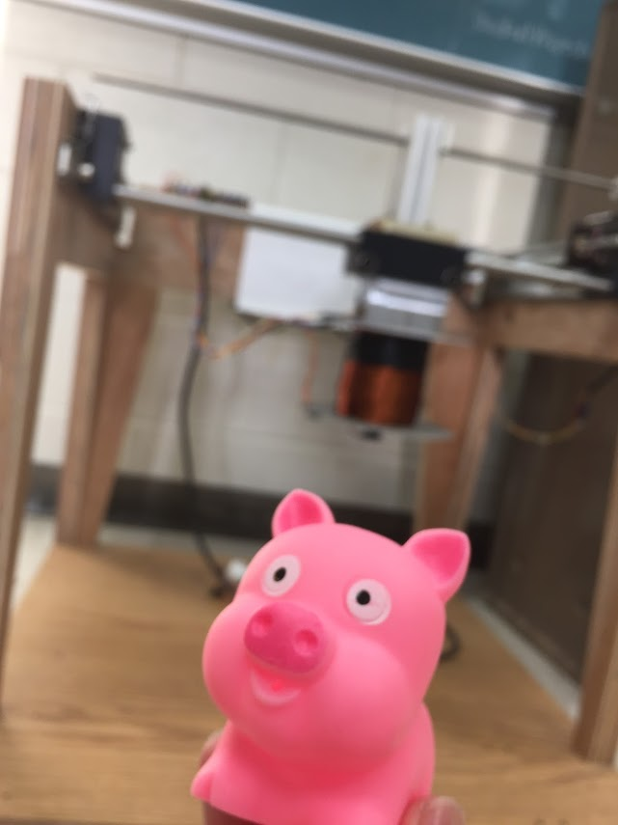
Projects: SCORE Crane Machine
Build a claw machine where “everyone wins”.
Will provide a fun way to distribute promotional items for the Southeastern Center of Robotics Education (SCORE).
Suspend a clawbot vertically, so people could use a joystick to manipulate it and pick up pens, squishy balls, etc. with the SCORE logo.
Team Lead:
Matthew Castleberry mtc0030@auburn.edu
Meetings:
Tuesdays 5:00pm-6:00pm
Location- SPARC Lab Broun 367

Slide 13
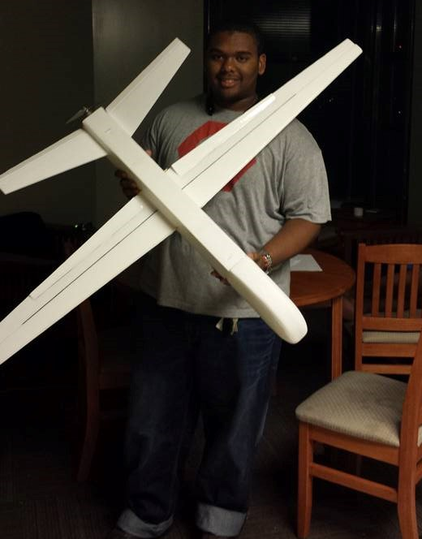
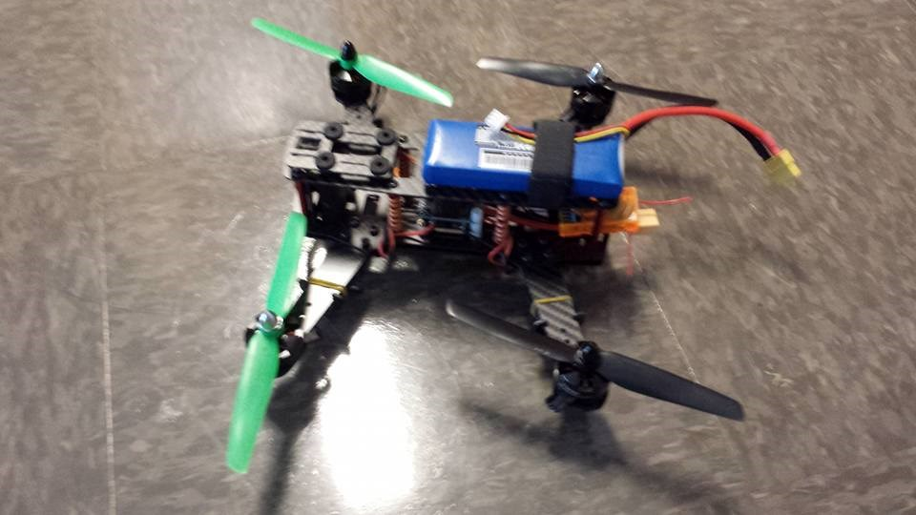
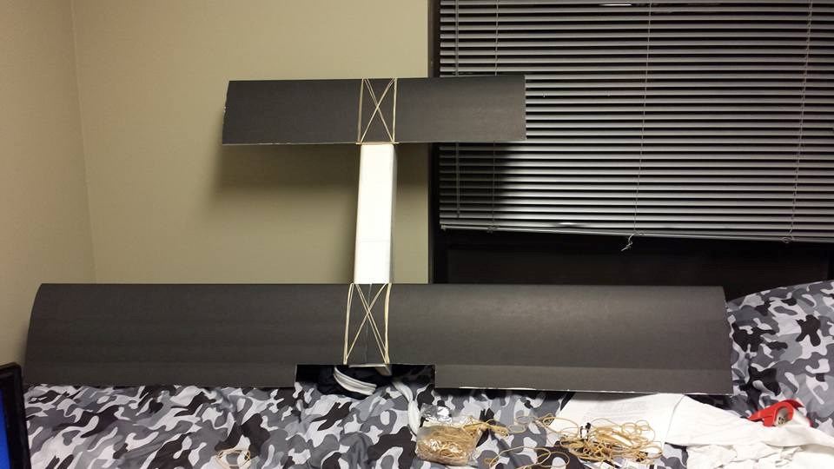
Projects: RC Hobbyist Club (RCHC)
Teaches 3D design, construction and control of RC airplanes, multi-copters, cars, and boats.
Designed to need no prior experience.
Functions very similar to SPARC
Meetings:
Mondays 5:00pm-6:00pm in Shelby
Fridays 3:00pm-4:00pm in Broun 235
Dues
$10 per semester
Club President
Joshua Parker jcp0048@auburn.edu

Slide 14
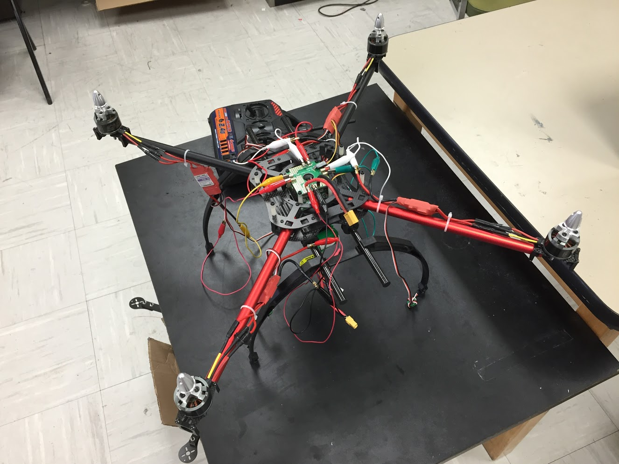
Projects: Quadcopter
A personal project by Josh.
3 years in the making
Joint project between SPARC and RC Hobbyist Club
Goals:
Solve an issue with one of the speed controllers and motors to enable the quadcopter to fly.
Possibly put an Arduino or Raspberry Pi on board for autonomous or semi-autonomous flight.
Team Lead:
Josh Jablonowski jdj0019@auburn.edu
Meetings:
Not set

Slide 15
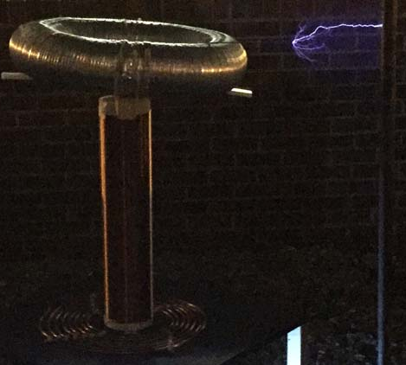
Projects: Tesla Coil
Last year we created a spark gap Tesla Coil.
It generated 400,000 volts of electricity
Goals this year:
Enhance it using homemade capacitors
Make it musical
Team Lead:
Matthew Castleberry mtc0030@auburn.edu
Meetings:
Not set

Slide 16
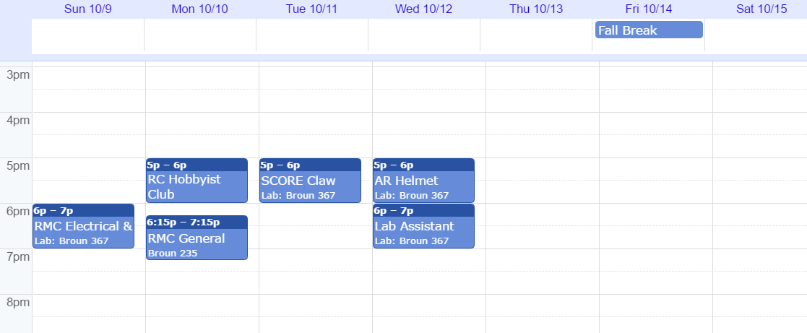
Meetings Schedule: Week of 10/9

Slide 17
Project Proposal Form
*Project Title: ____________________
*Project Description: ______________
____________________________________
Proposal Date: __/__/__
Expected Finish Date: __/__/__
*Funding Needed (Yes/No): __________
Proposed Budget: ___________________
*Project Lead: _____________________
Other Members: _____________________
For completion by an officer and the advisor:
Officer Name: _______________ Date: __/__/__
Advisor Name: _______________ Date: __/__/__
Can be found on the Github:
https://github.com/SPARC-Auburn/Documents/blob/master/Forms/Project%20Proposal%20Form.txt

Slide 18




Project Item Order Form
Project Title: ________________
Form Submission Date: __/__/___
Item Name: ____________________
Vendor: _______________
Link: _________________
Part #: _______________
Amount: _______________
Price Per Each: $______
Price Total: $_________
…
Total Cost (no shipping or taxes):
$________
Can be found on the Github:
https://github.com/SPARC-Auburn/Documents/blob/master/Forms/Project%20Item%20Order%20Form.txt

Slide 19
SPARC T-SHIRT Order Forms
The SPARC T-Shirt is a Blue Jean colored short sleeve Comfort Color T-Shirt. Please fill out the following information, paper clip cash or check for the respective amount, and give it to a SPARC Officer or Dr. Roppel.
First Name:________________
Last Name:________________
Auburn Email: _______@auburn.edu
Circle a Size:
Small- $11
Medium- $11
Large- $11
X-Large- $11
2X-Large- $12
3X-Large- $13

Slide 20
Maker Training Sessions
Thursday, October 6th- Solidworks/3D Design
Thursday, October 13th - No Meeting for Fall Break
Thursday, October 20th- TAZ LulzBot/3D Printing
Thursday, October 27th- Github/Version Control Software
Thursday, November 3rd- Robotics/Control Systems
Thursday, November 10th – Web Development
*meeting topics may be subject to change as needed

Slide 21
Useful Links
Website
http://sparc-auburn.github.io/
Github
https://github.com/SPARC-Auburn
SPARC Documents
https://github.com/SPARC-Auburn/Documents

Slide 22
What is CAD and SolidWorks?
CAD stands for Computer Aided Design.
Solid modeling CAD software examples:
Google SketchUp
http://www.sketchup.com/
SolidWorks
https://imapssl.eng.auburn.edu/software/software/showcase.php?software=solidworks
Autodesk
https://imapssl.eng.auburn.edu/software/software/showcase.php?software=autodesk
Solid Edge
https://www.plm.automation.siemens.com/en_us/academic/resources/solid-edge/student-download.cfm?stc=deiia400744
PTC Creo
http://www.ptc.com/academic-program/products/free-software/creo-college-download

Slide 23

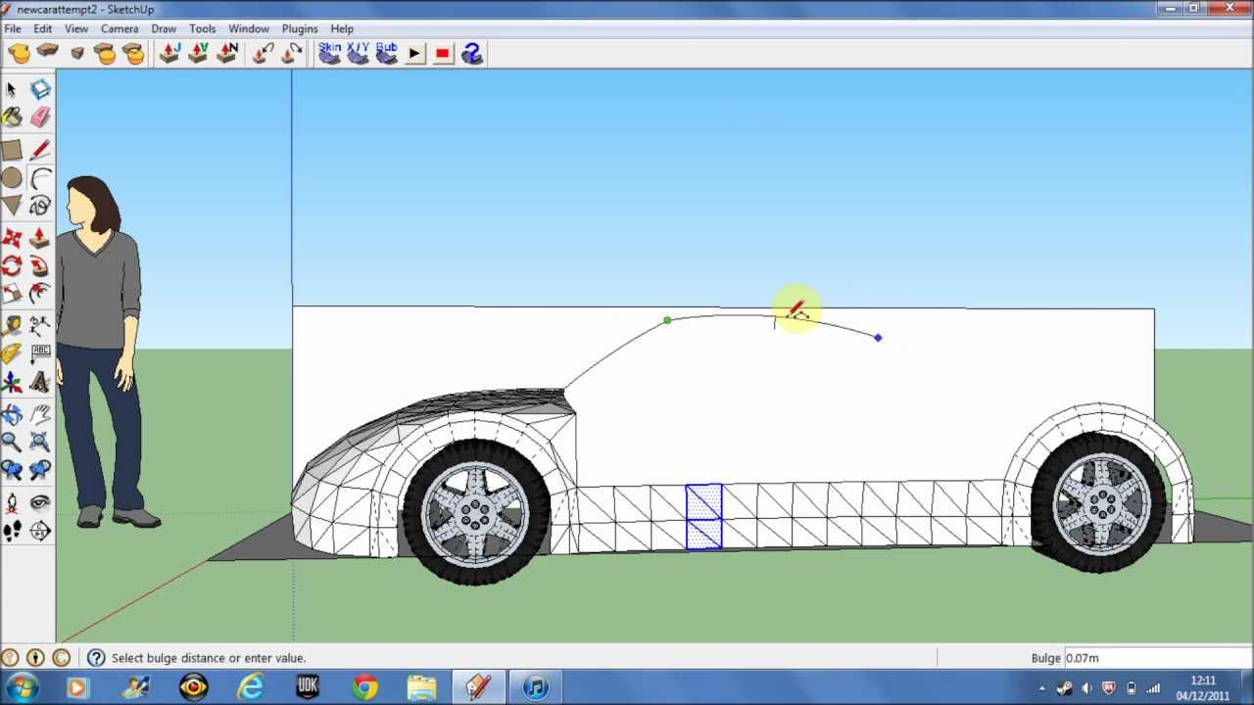
Google SketchUp
Great for beginners because of its intuitiveness.
Low complexity
Extensive built-in library of models.

Slide 24

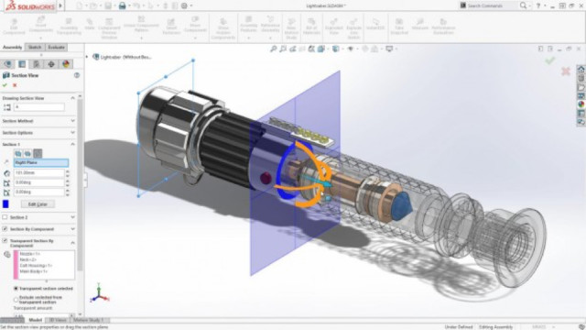
SolidWorks
Great for precision design work but is more complex.
Has very powerful simulations.
Is used by many companies yet is free for students

Slide 25
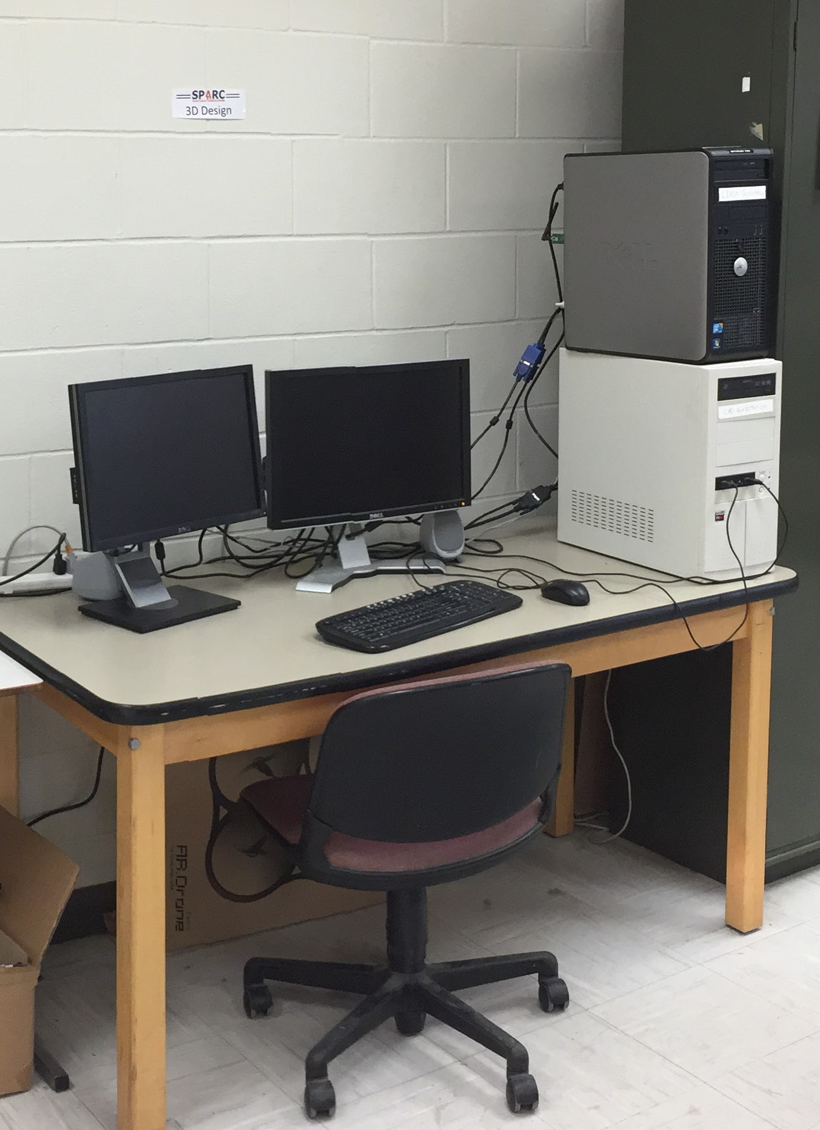
How to Access SolidWorks
Use the SPARC CAD Workstation
Use an Engineering Network Services Computer Lab
Broun 123
Shelby 1202,2119,2122,2210
Davis 123,330
Ross 306,370
Download the student version
https://imapssl.eng.auburn.edu/software/software/showcase.php?software=solidworks

Slide 26
Minimum Computer Requirements
Windows 7, 8.1, 10 64-bit
Macbook users must use Windows in Boot Camp or virtual machine
8GB or RAM or higher is recommended
4GB works but is slow
Must have physical mouse with center wheel
Laptop touchpads do not work
At least 8GB of Storage space

